Slide 1

Unity Physics Add Impulse to Rigidbody
jintaeks@dongseo.ac.kr
May 10, 2019

Slide 2
Linear momentum, translational momentum, or simply momentum(pl. momenta) is the product of the mass and velocity of an object.
It is a vector quantity, possessing a magnitude and a direction in three-dimensional space.
If m is an object's mass and v is the velocity (also a vector), then the momentum is
p = mv

Slide 3
Many particles
The momentum of a system of particles is the vector sum of their momenta. If two particles have respective masses m₁ and m₂, and velocities v₁ and v₂, the total momentum is
The momenta of more than two particles can be added more generally with the following:

Slide 4
If the net force F applied to a particle is constant, and is applied for a time interval Δt, the momentum of the particle changes by an amount
In differential form, this is Newton's second law; the rate of change of the momentum of a particle is equal to the instantaneous force F acting on it,

Slide 5
If the net force experienced by a particle changes as a function of time, F(t), the change in momentum (or impulse J ) between times t₁ and t₂ is

Slide 6
Unity Demo

Slide 7
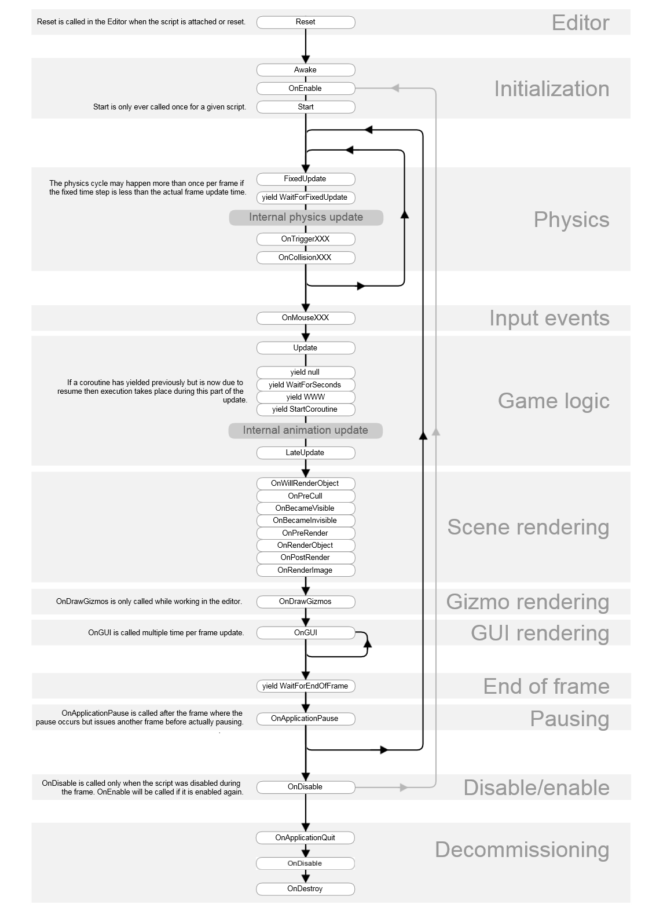
Notes:
https://answers.unity.com/questions/713217/exact-difference-between-fixeddeltatime-and-deltat.html
I don't know the reason your game lags but the use you are giving to Time.deltaTime and Time.fixedDeltaTime is possibly wrong.
Time.deltaTime is the time interval between current frame and the last one, which is the same than the time interval between two call to the Update() method. This means that Update() is going to be called a different number of times depending on the performance of your game.
On the other hand you have the method FixedUpdate() which works essentially as Update() but with the difference that it is going to be called a fixed amount of times per second. Naturally Time.fixedDeltaTime is the difference between two calls of FixedUpdate()and it always holds the same value.
As you see, it would make no sense using Time.fixedDeltaTime in the Update() method, if you do so you should move the logic that uses Time.fixedDeltaTime to the FixedUpdate()method. Same goes for Time.deltaTime, it is wrong (or at least very wierd) to use it in FixedUpdate().
Personally I use Update() for input recognition, since it is more likely to catch a key because it gets called more often. I use FixedUpdate() for everything else.

Slide 8
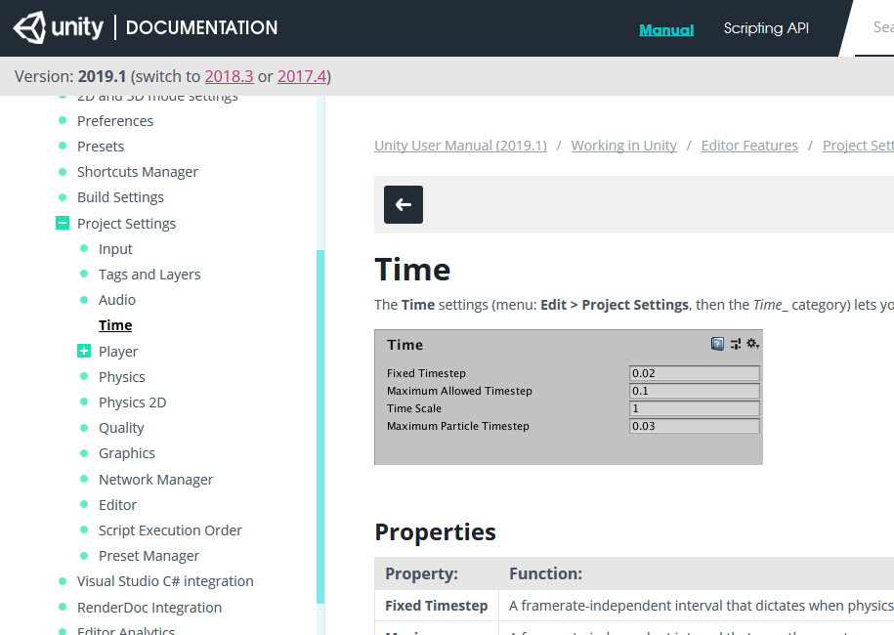

Slide 9
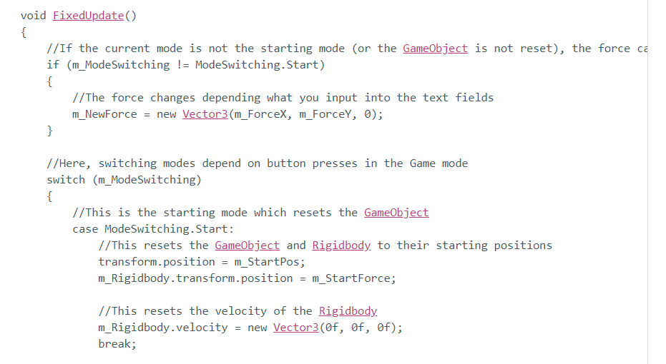

Slide 10
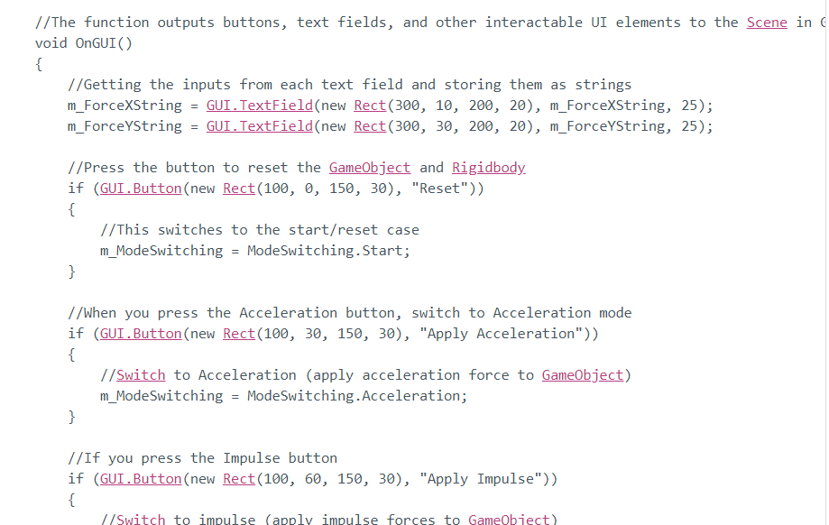

Slide 11
Demo

Slide 12
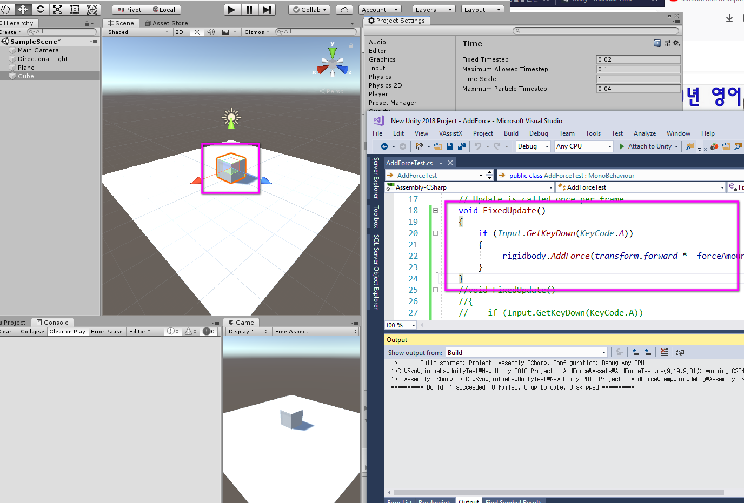

Slide 13
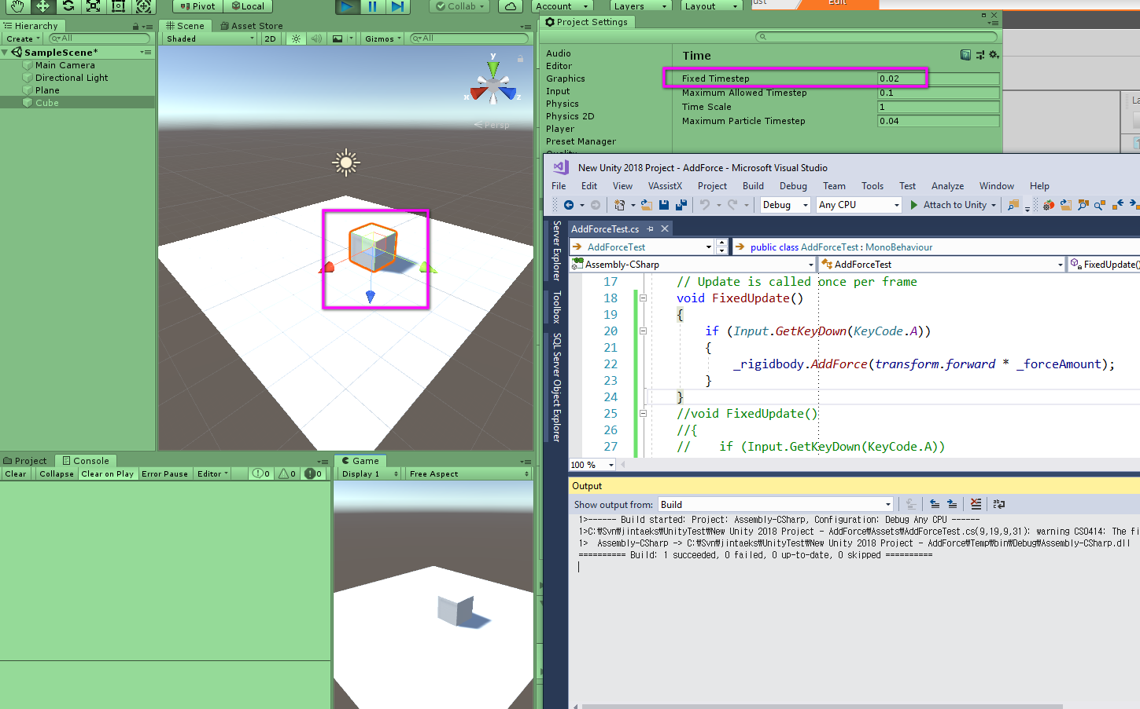

Slide 14
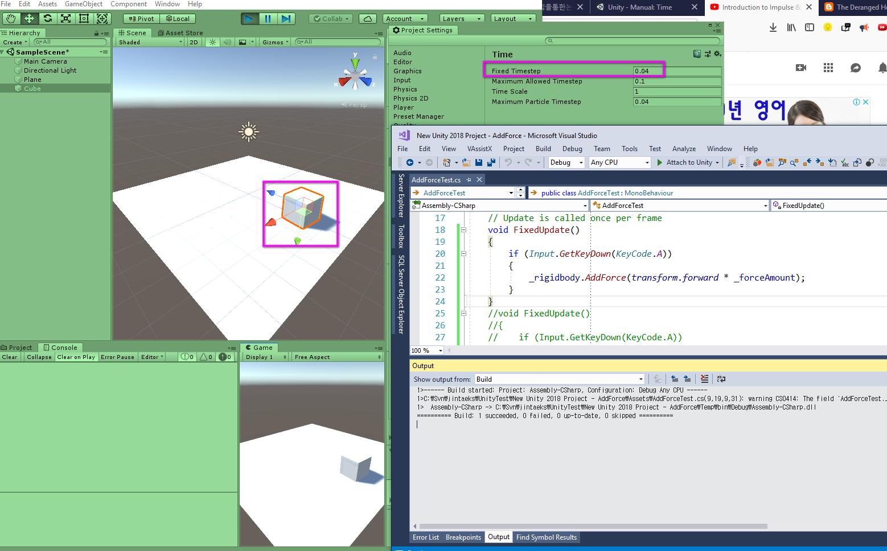

Slide 15
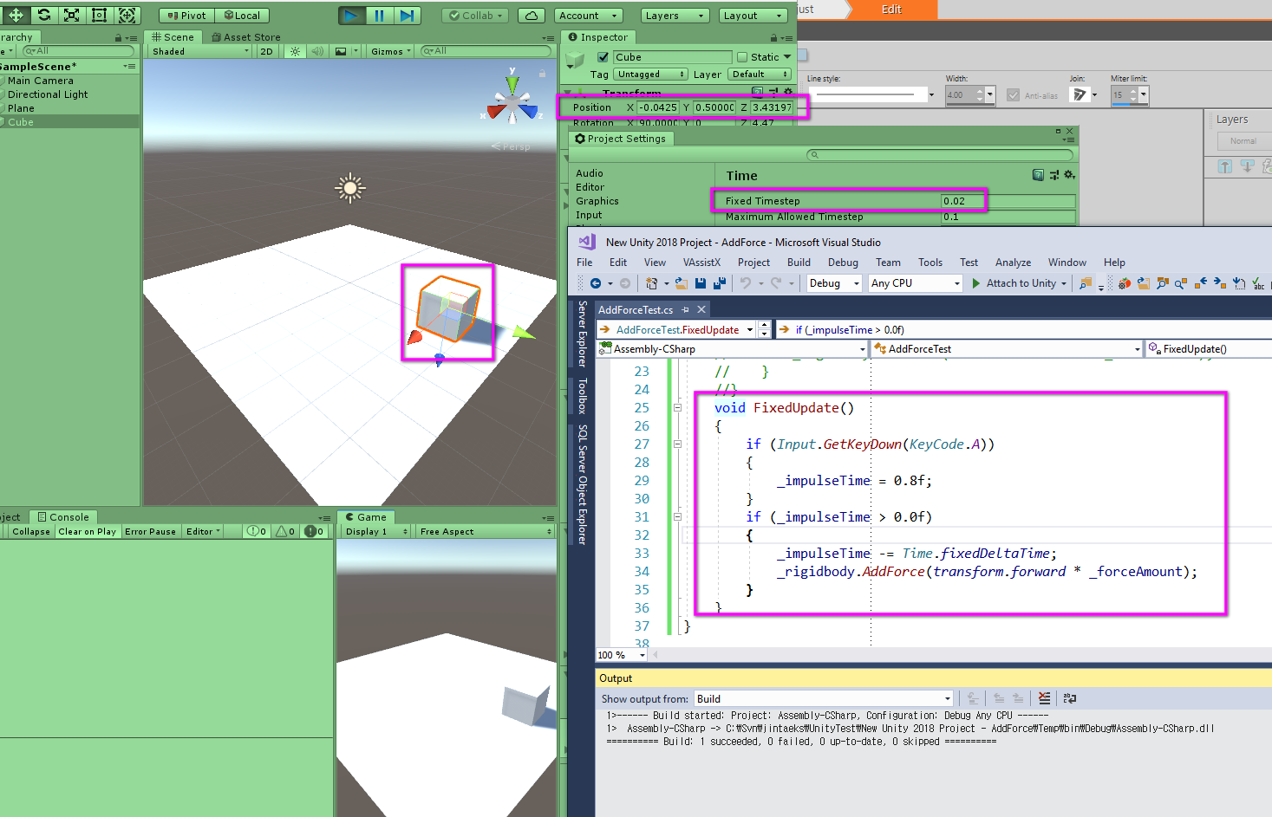

Slide 16
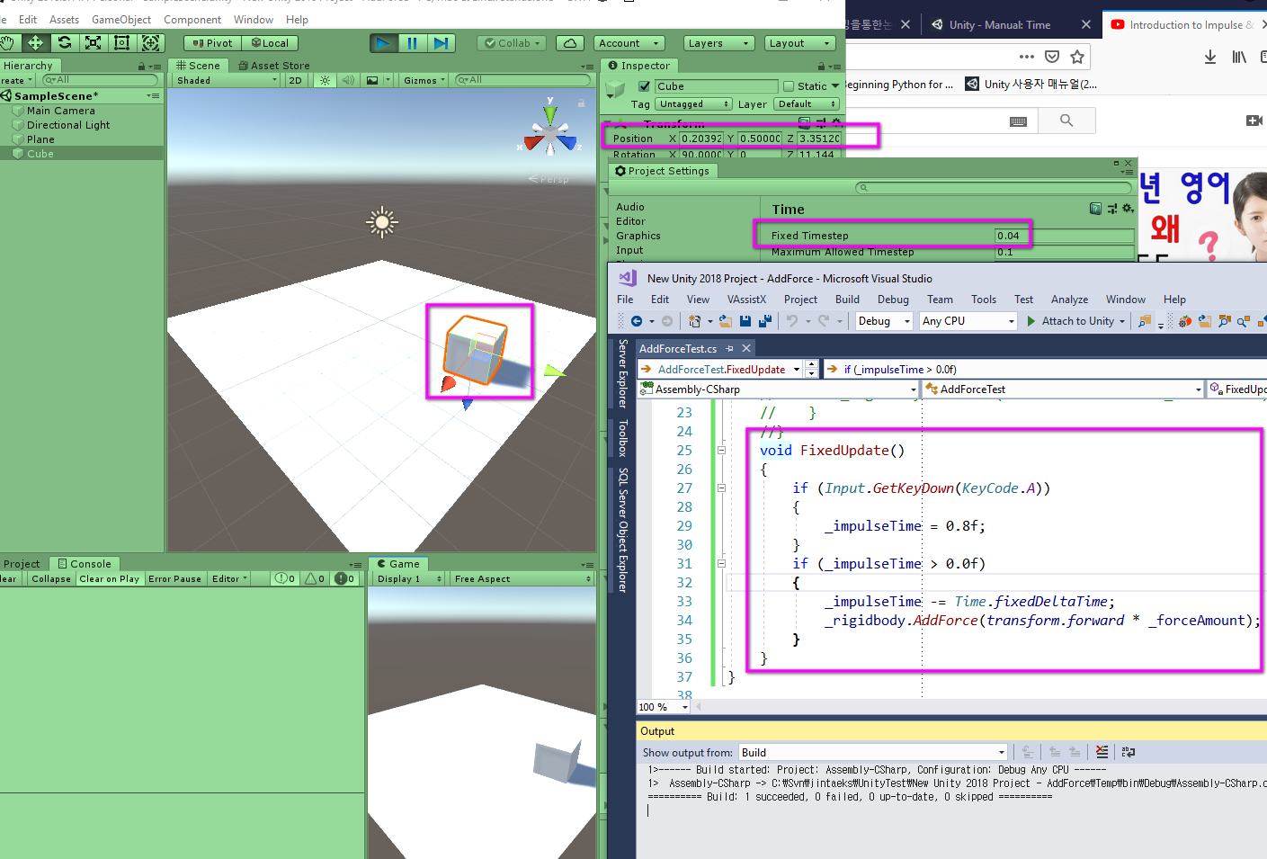

Slide 17
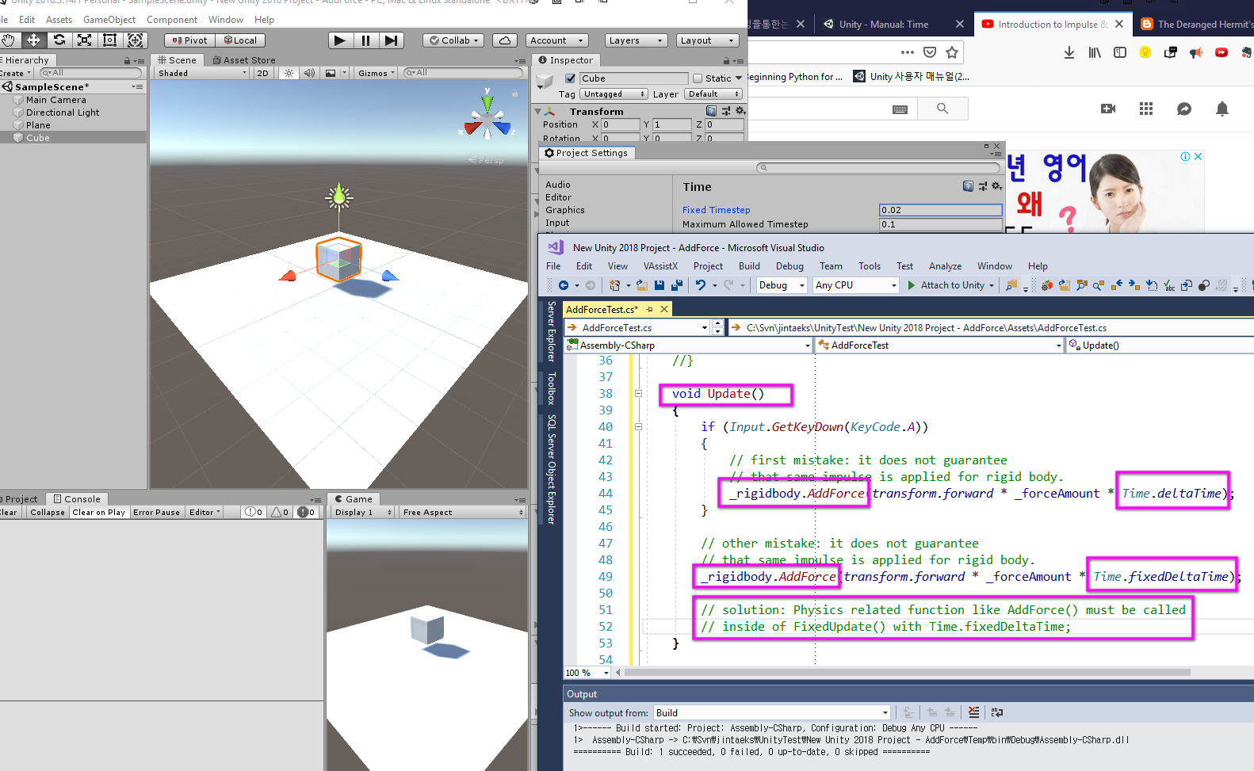

Slide 18
Wrong Usage Example

Slide 19
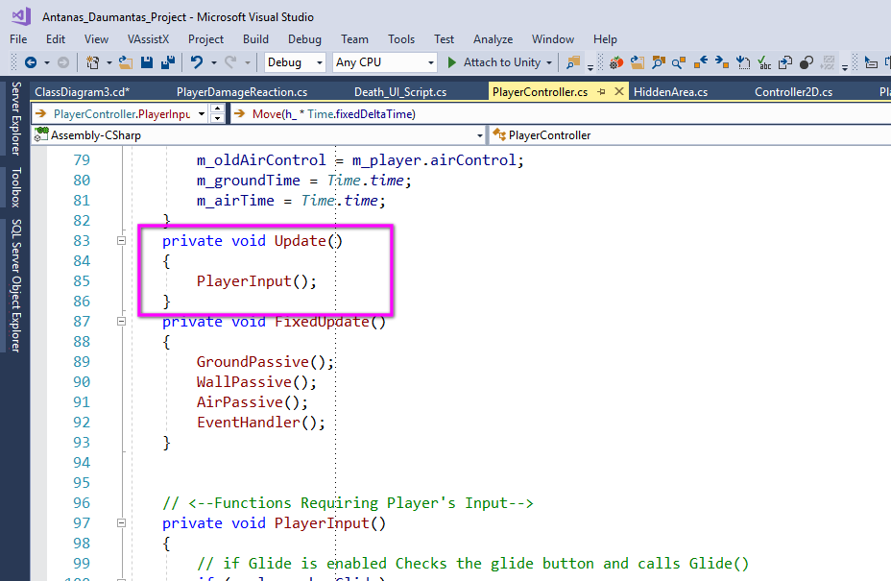

Slide 20
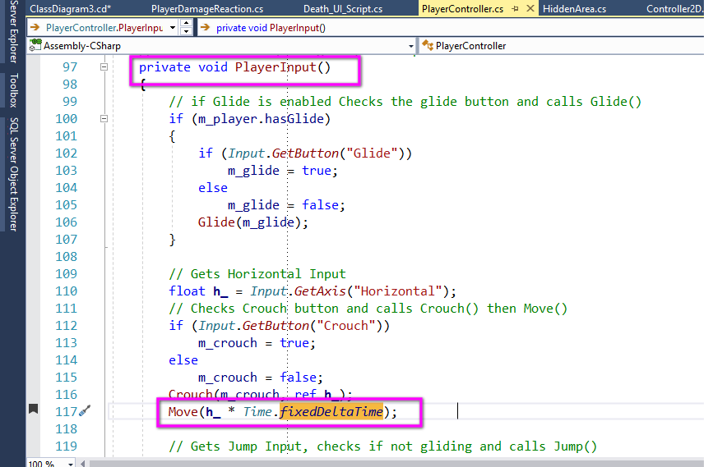

Slide 21
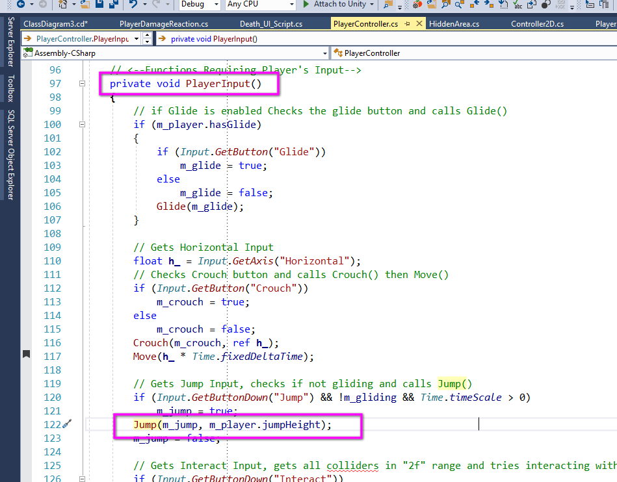

Slide 22
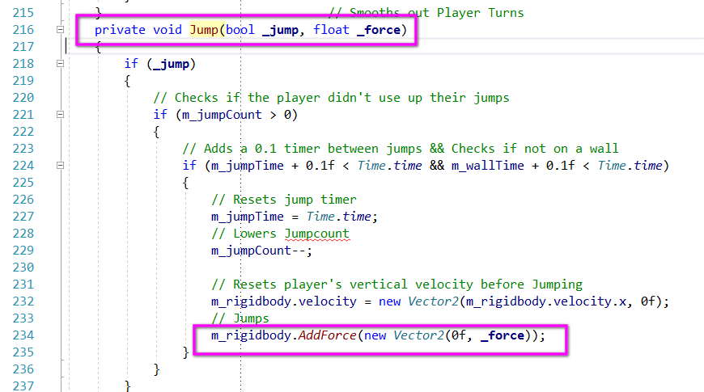

Slide 23
References
https://en.wikipedia.org/wiki/Momentum
https://docs.unity3d.com/ScriptReference/ForceMode.Impulse.html
https://answers.unity.com/questions/713217/exact-difference-between-fixeddeltatime-and-deltat.html

Slide 24

QnA

